Slide 1
ICA : Multimodal Document Layout Components Classifier [DocGCN]
Shashank Sahoo
6th July 2023
KPMG UK
KPMG Framework Slides v1
February 2022

Slide 2
Introduction
01

Slide 3
Introduction
Digital documents (incl. scanned document images and PDF files) are popular and convenient for storing written textual information, as almost 2.5 trillion documents worldwide are available in the digital format.
Recognizing the layout of unstructured digital documents (pdf, png, jpg, tiff etc.) is crucial when parsing the documents into the structured, machine-readable format for downstream application.
Generally, document layout components comprises of Text, Title, List, Table, Figure, Question, Answer, Header, Footer etc.
Current Document Layout Analysis (DLA) algorithms usually rely on visual cues to understand documents while ignoring other information, such as contextual information or the relationships between document layout components, which are vital to boost better layout analysis performance.
The DLA task aims at understanding the documents from either
the physical analysis by detecting the document structure and the boundaries of each layout region or
the logical analysis by categorizing the detected layout components (segments) into the predefined document element classes, such as Title, Date, Author, and Figure.

Slide 4
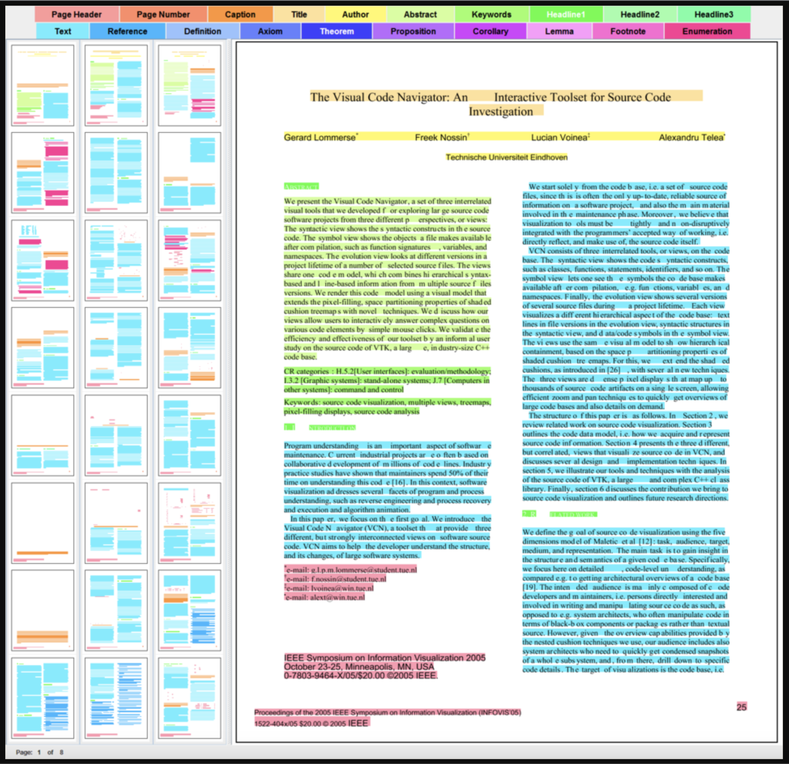
Sample DLA Components
Text
Title
List
Table
Figure
Question
Answer
Header
Footer
Other
Source : AG Keim - Datenanalyse und Visualisierung (uni-konstanz.de)

Slide 5
Proposal Goal
02

Slide 6
Proposal Goal
Goal
The comprehensive aspect of DLA is generally missed with existing approaches as they ignore to comprehend the visual and logical relationship between components and focus purely on key-value pair relationships only.
We have devised a method called DocGCN using Graph Convolutional Networks (GCNs) for DLA which incorporates a holistic perspective to achieve better and enhanced representation of all document features.
DocGCN stands for Heterogenous Graph Convolutional Networks for DLA
We propose DocGCN as an open-source alternative to achieve enhanced feature extraction and representation of document components to perform critical analysis such as identification and classification of components into its constituent elements and provide relation mapping based metadata.
Plan
The idea is to design, build and deploy a heterogeneous/multimodal deep-learning based model to perform document layout analysis using Graph Convolution Networks on unstructured digital documents.
Furthermore, we intend create an inferencing microservice with the support of MSP team to deploy the weights from the trained model for inferencing on any sample digital document.
Currently, it will be scoped as part of ICA offering for Phase II release.
DocGCN microservice could also be leveraged by other solution teams at KIT to perform DLA for their respective downstream tasks.

Slide 7
DocGCN : Solution Components
03

Slide 8
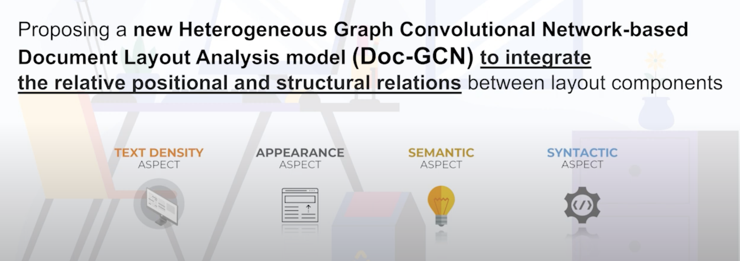
Solution Components
Doc-GCN presents an effective way to harmonize and integrate heterogeneous aspects for Document Layout Analysis. The proposed Doc-GCN contains graphs covering four different aspects of properties of digital document pages, including syntactic, semantic, density, and appearance/visual information . It used graph as a fundamental data structure to represent the document features for Graph based convolutional neural networks
Typically the entire solution can be segregated into the following components as a way forward for implementation:
Density-aspect and Appearance-aspect Graph construction
Characteristics such as text density, total characters, text colour, format, font-size etc is considered.
Syntactic-aspect and Semantic-aspect Graph construction
Characteristics such as parts of speech (Noun, Verb, Adjectives, Adverbs) and self-attention based text embeddings is considered.
Relation Prediction Model to classify components

Slide 9
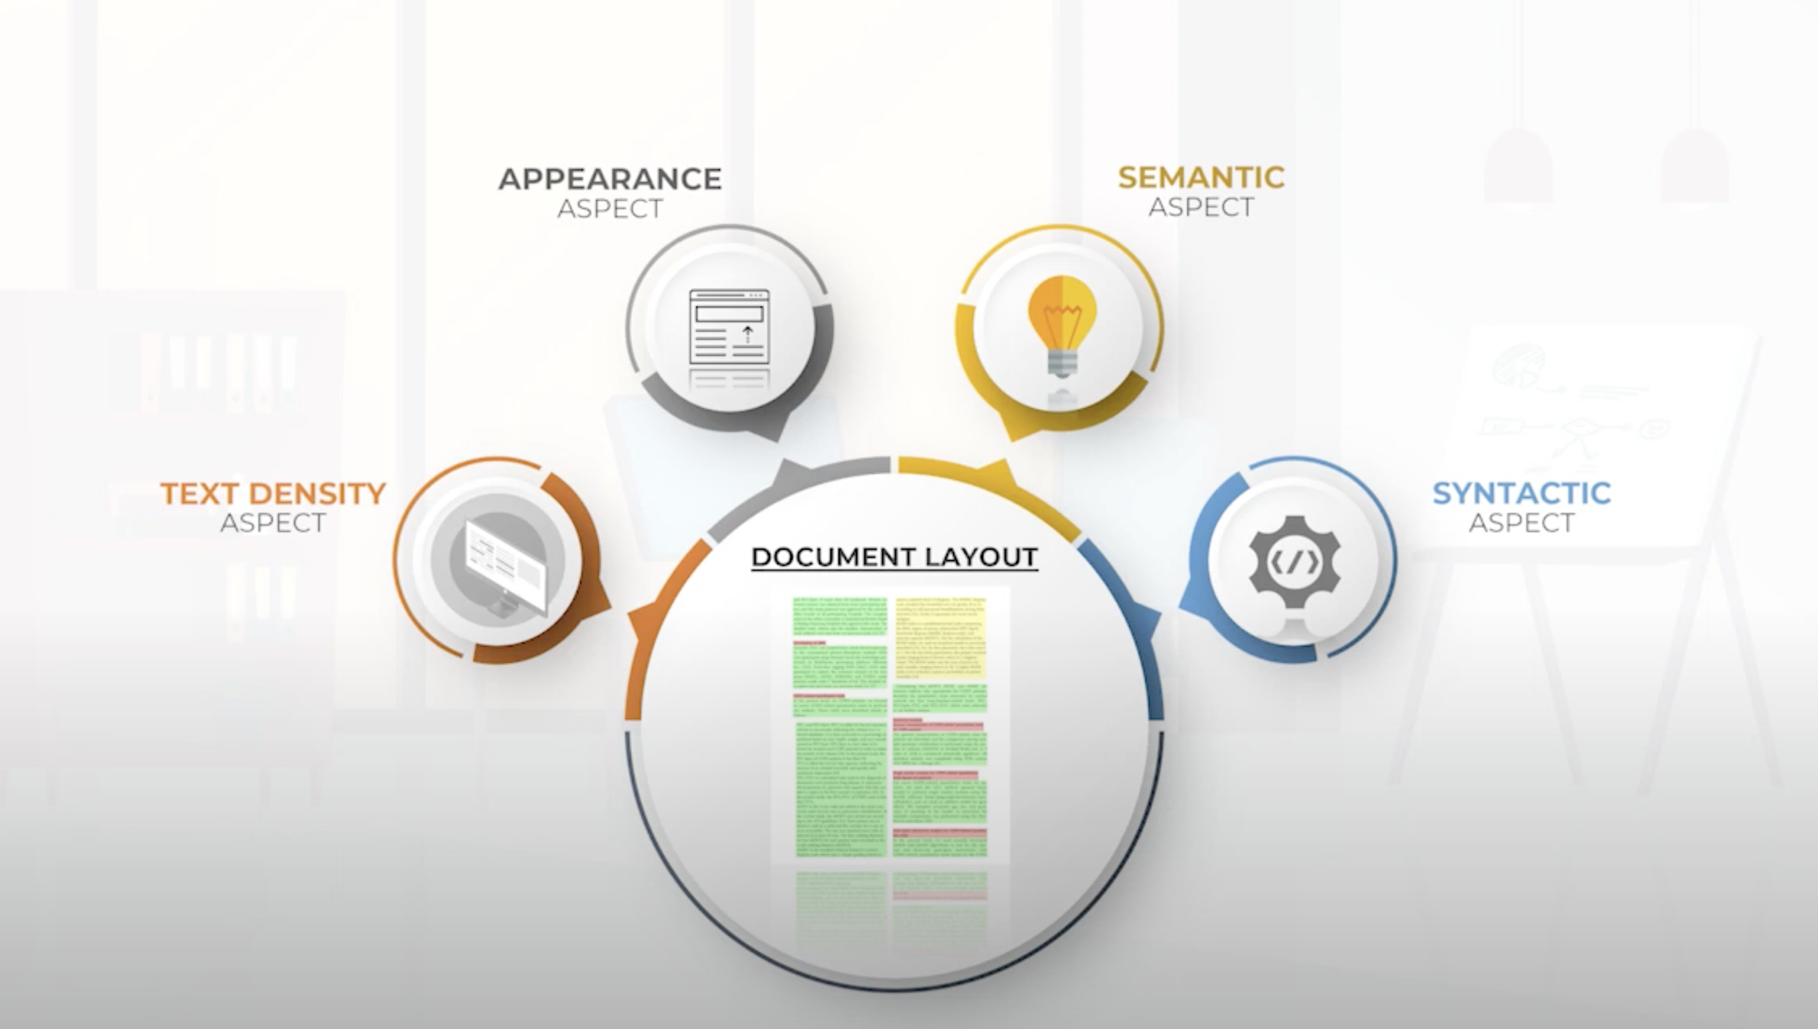
Solution Components [cntd.]

Slide 10
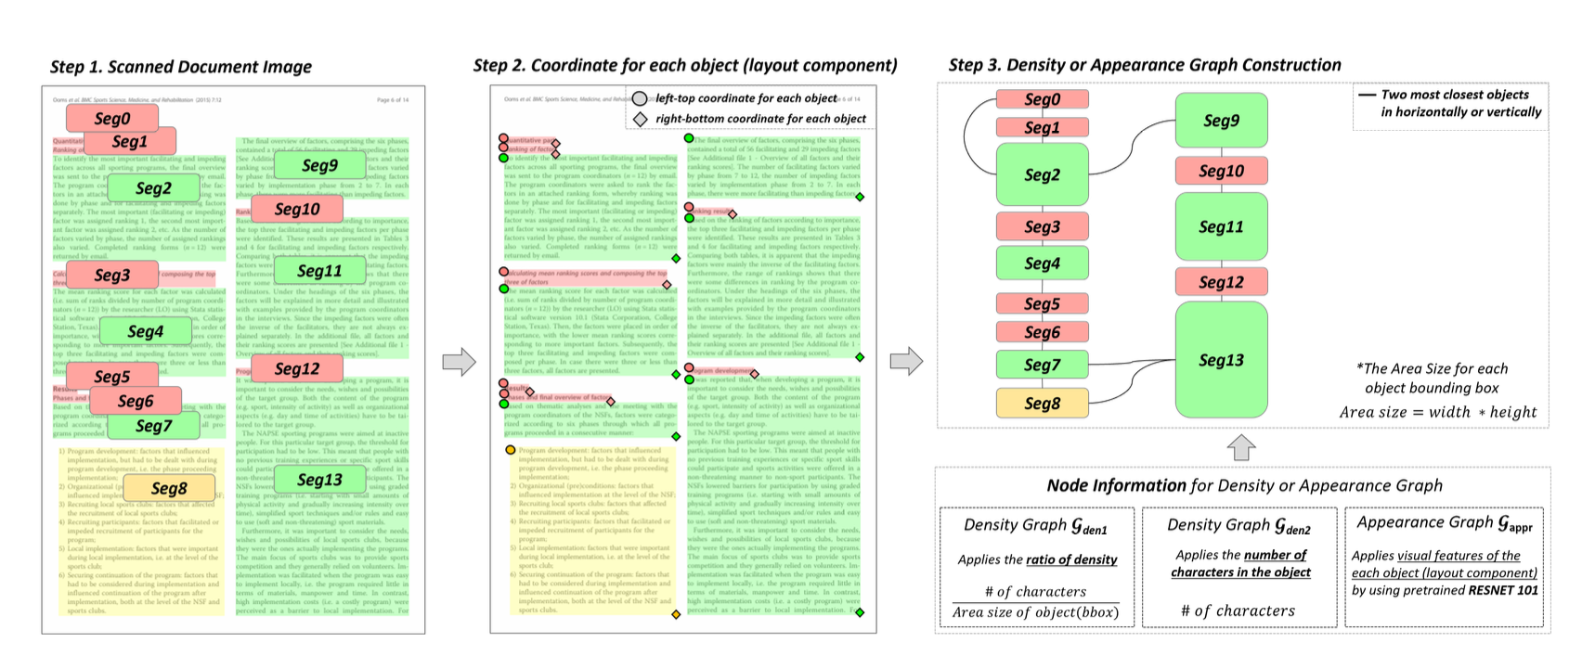
Density-aspect and Appearance-aspect Graph

Slide 11
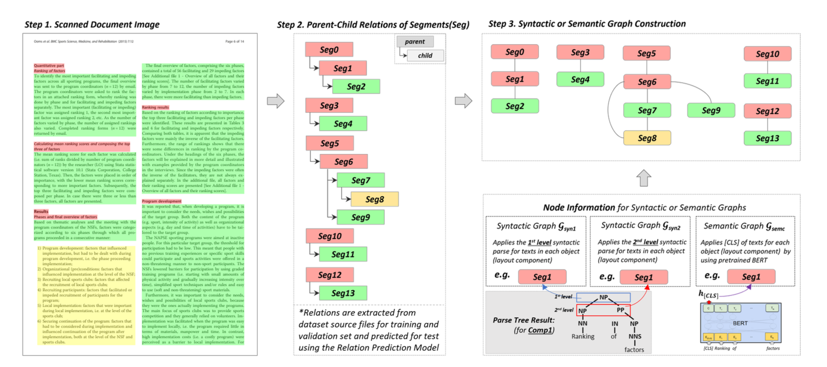
Syntactic-aspect and Semantic-aspect Graph

Slide 12
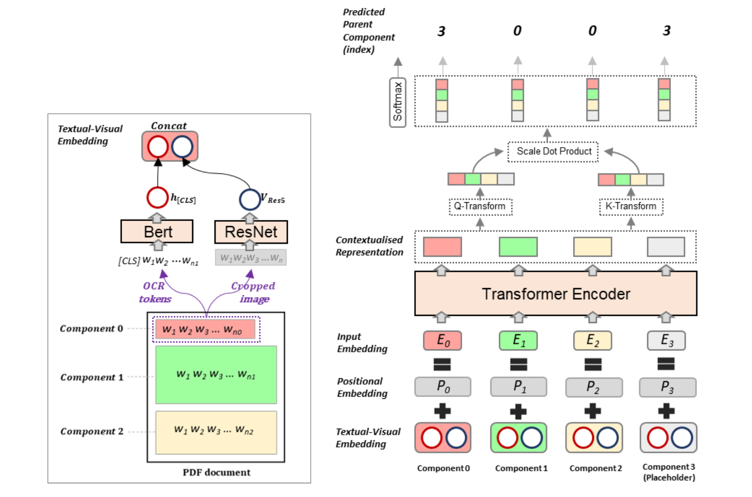
Relation Prediction Model

Slide 13
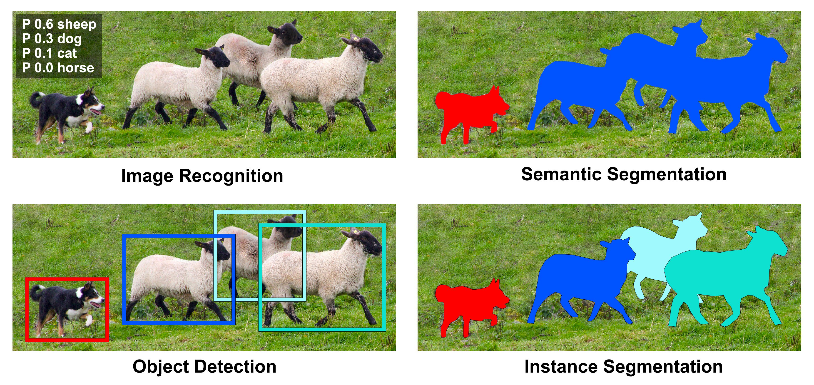
Detectron2 Module
Detectron2 is Facebook AI Research’s (FAIR) next generation library that provides state-of-the-art object detection and
segmentation algorithms. It is the successor of Detectron and maskrcnn-benchmark.
It is now implemented in PyTorch. Detectron2 is flexible and extensible, and able to provide fast training on single or
multiple GPU servers. Lots of pre-trained models available in Model Zoo to experiment with.
Includes new capabilities such as panoptic segmentation,
Densepose, Cascade R-CNN, rotated bounding boxes, PointRend,
DeepLab, ViTDet, MViTv2 etc.
Detectron2 based models can be exported to TorchScript format or
Caffe2 format for deployment. It trains much faster than
predecessor. Its extensible design makes it easy to implement
cutting-edge research projects without having to fork the entire codebase.
Outputs
Class Label
Prediction %
Bounding box
Segmented Masks
Object bare skeleton

Slide 14
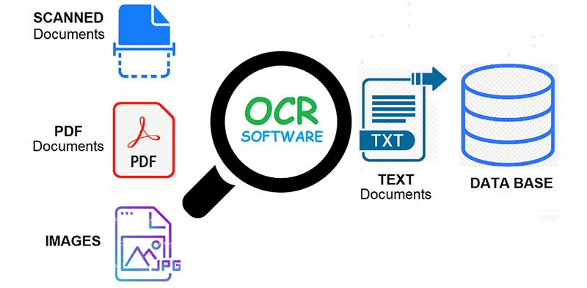
Tesseract OCR
Tesseract is an open-source OCR engine developed primarily by HP and later managed by Google that recognizes more than
100 languages, along with the support of ideographic and right-to-left languages. Also, we can train Tesseract to recognize other languages.
It contains two OCR engines for image processing and character recognition – a default LSTM (Long Short Term Memory) OCR engine
and a legacy OCR engine that works by recognizing character patterns.
The OCR engine uses the Leptonica library to open the images and supports various output formats like plain text,
hOCR (HTML for OCR), PDF, and TSV.
First part is to read the image using OpenCV and then pass the
image to image_to_string() or image_to_data() method of the
pytesseract class along with the language (eng).
Operation Modes
0 Legacy engine only.
1 Neural nets LSTM engine only.
2 Legacy + LSTM engines.
3 Default, based on what is available.

Slide 15
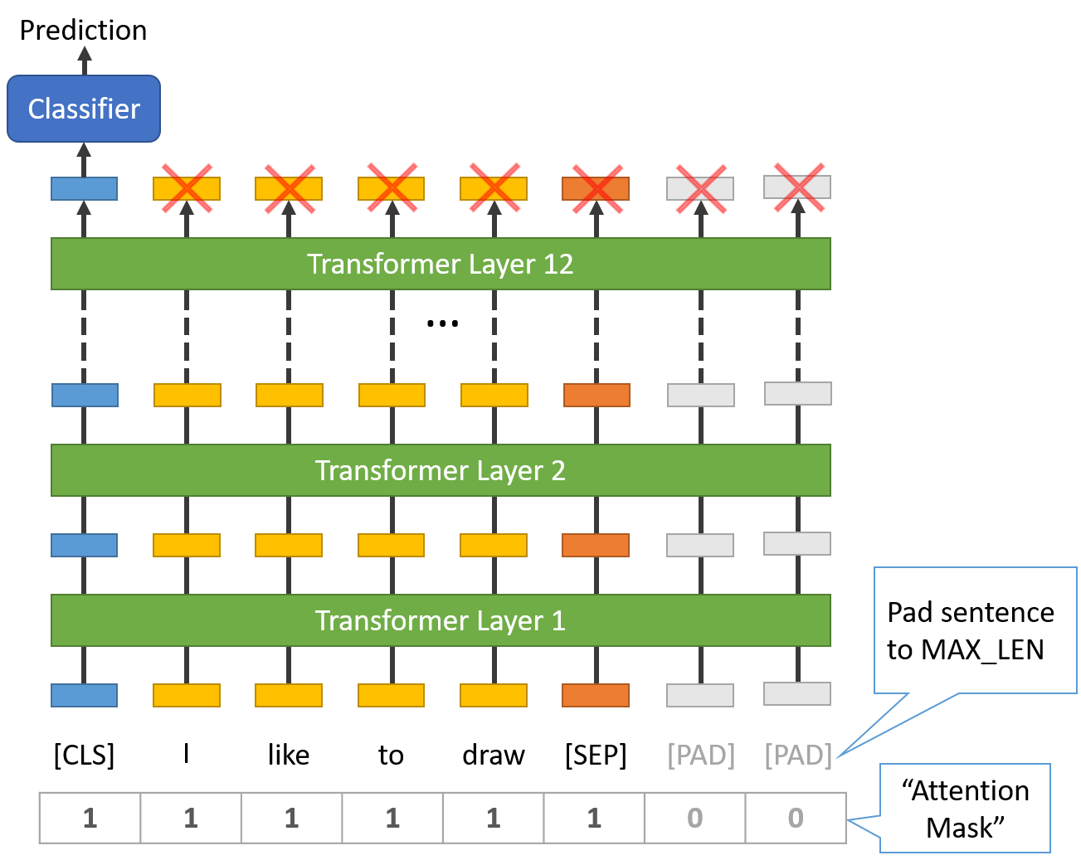
Pretrained BERT
BERT is a transformers model pretrained on a large corpus of English data in a self-supervised fashion.
This means it was pretrained on the raw texts only, with no humans labelling them in any way with an
automatic process to generate inputs and labels from those texts.
Masked language modeling (MLM):
Taking a sentence, the model randomly masks 15% of the words in the
input then run the entire masked sentence through the model and it
has to predict the masked words.
Next sentence prediction (NSP):
The models concatenates two masked sentences as inputs during pretraining.
Sometimes they correspond to sentences that were next to each other in the
original text, sometimes not. The model then has to predict if the two
sentences were following each other or not.
This way, the model learns an inner representation of the English language
that can then be used to extract features useful for downstream tasks.
A standard classifier uses the features produced by the BERT model as as inputs.

Slide 16

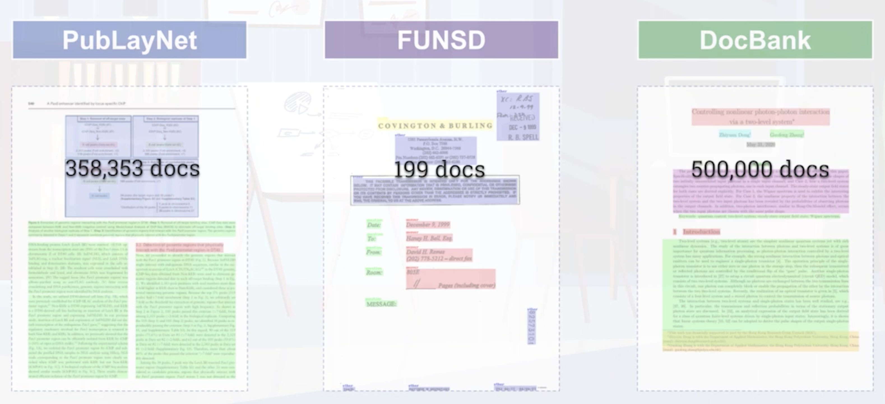
Dataset

Slide 17
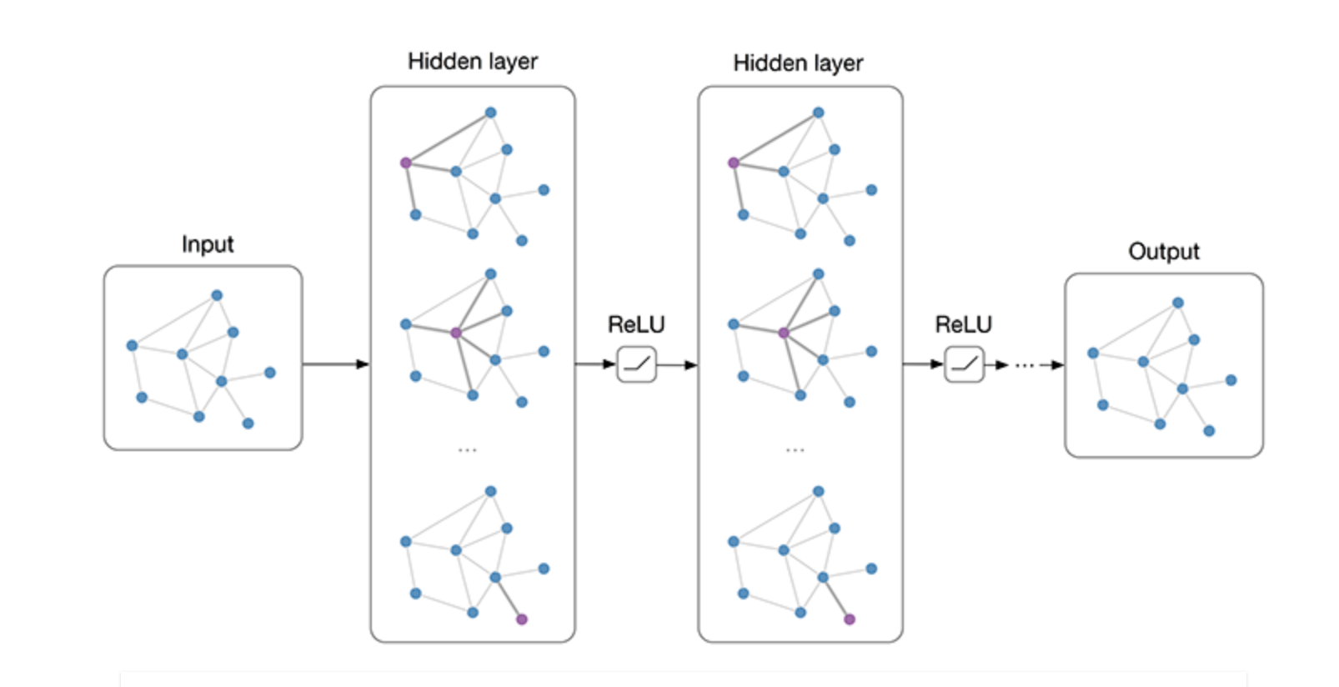
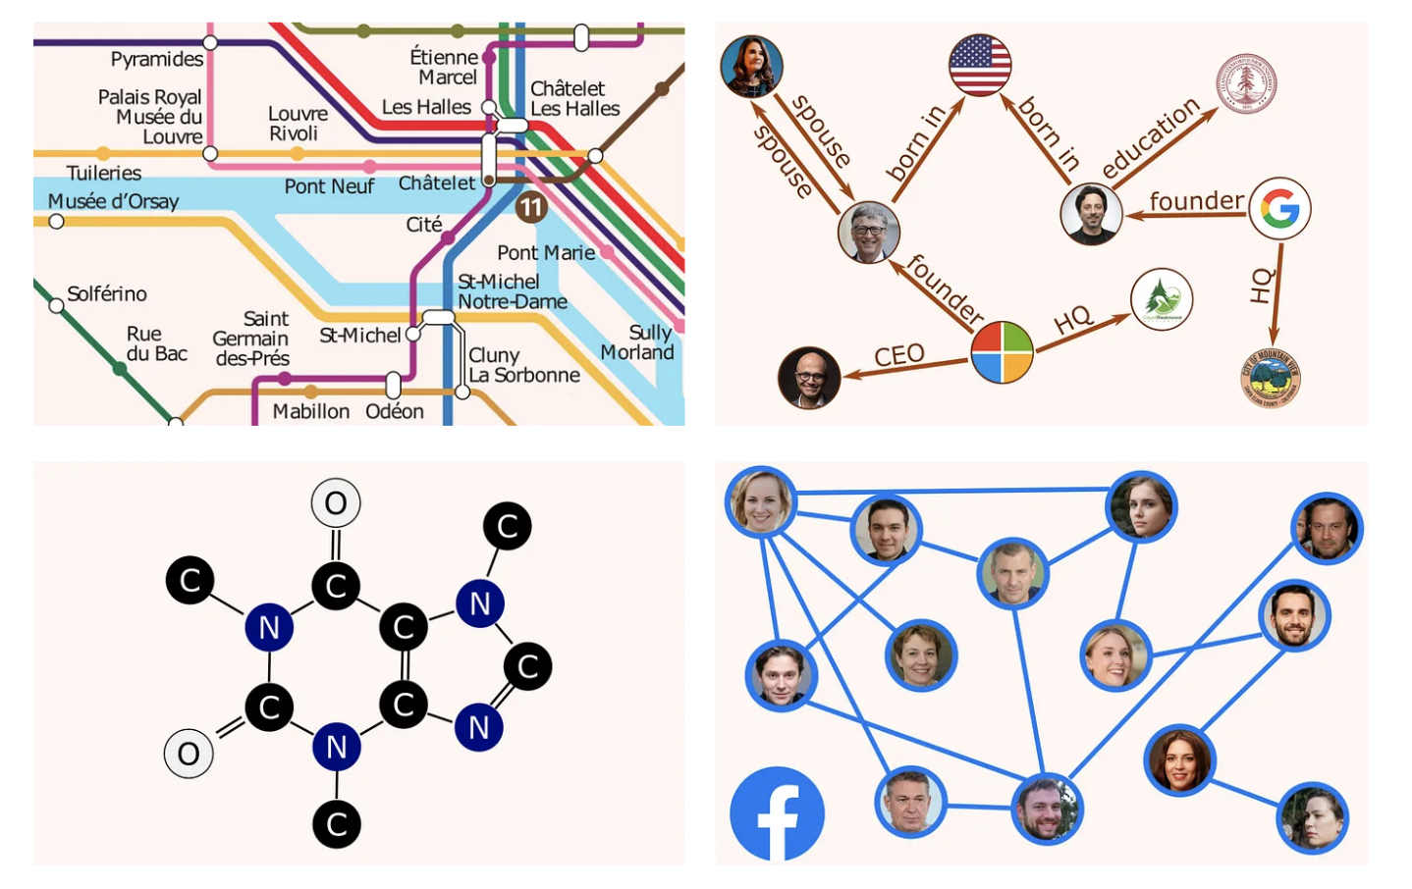
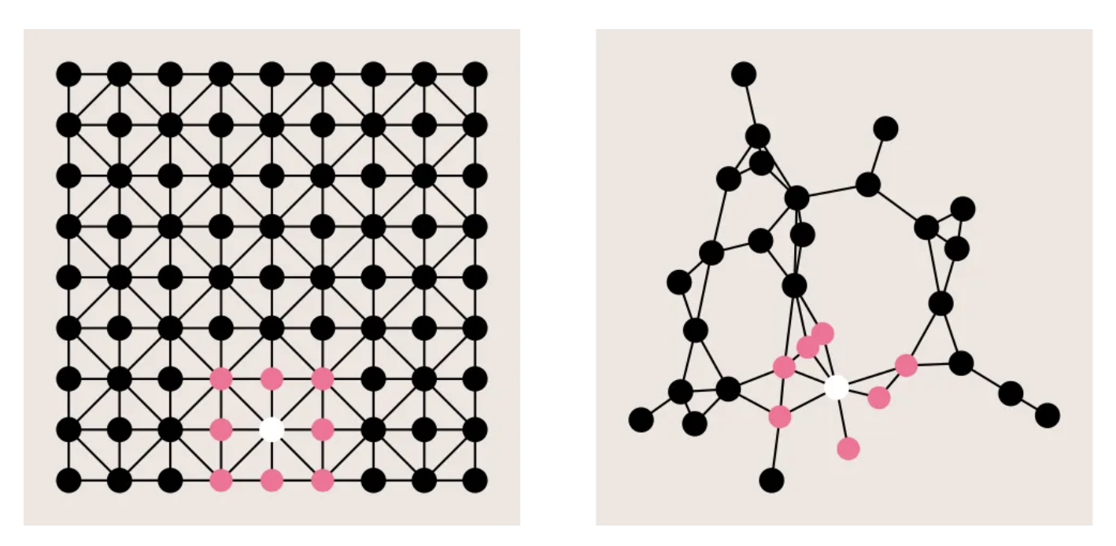
Graph Convolutional Networks - GCN
Graphs are among the most versatile data structures, thanks to their great expressive power. Used typically to extract and predict information on data lying on graphs, to model complex elements and their relations. Here are just some examples.
Traffic patterns forecasting on road networks
Inferring missing information in a Knowledge Graph
Predicting protein interactions for drug discovery
Recommender systems based on social networks data
Graph data are non-structured and non-Euclidean

Slide 18
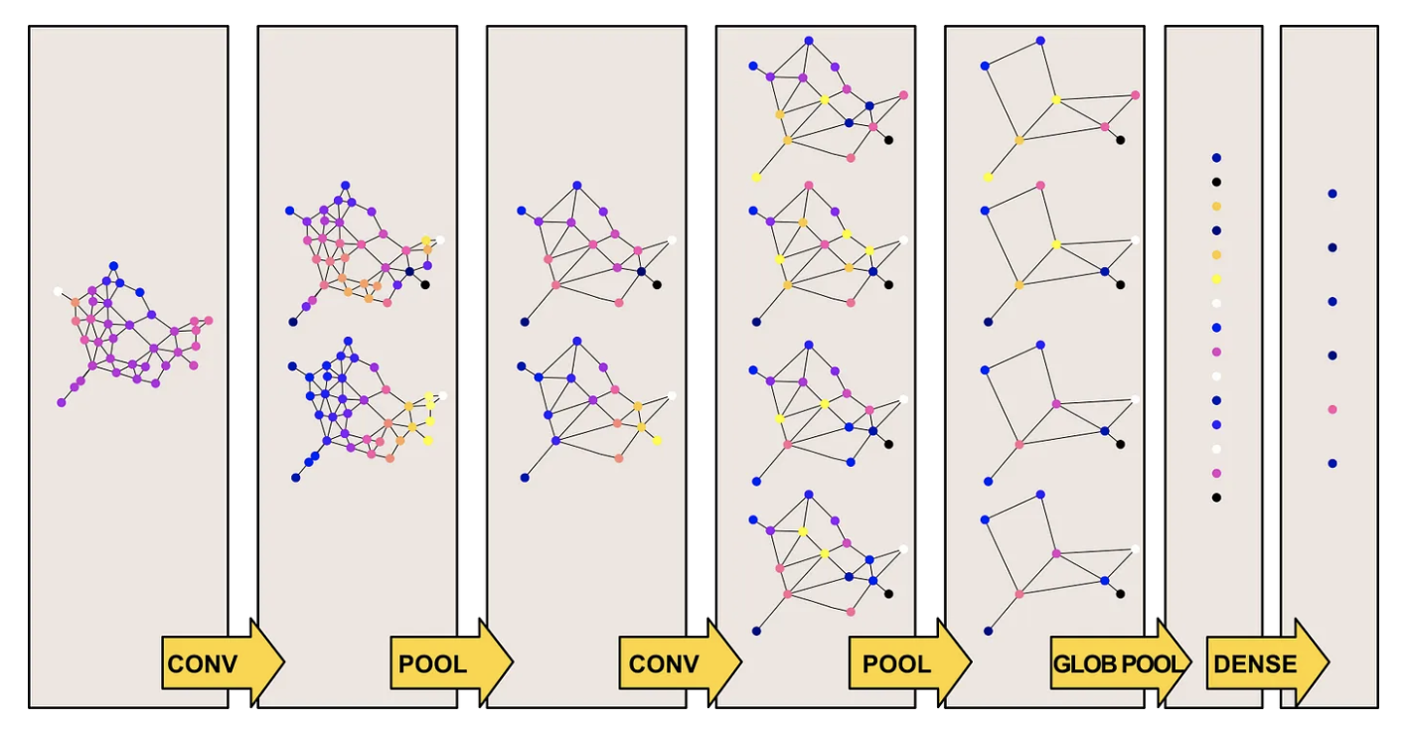
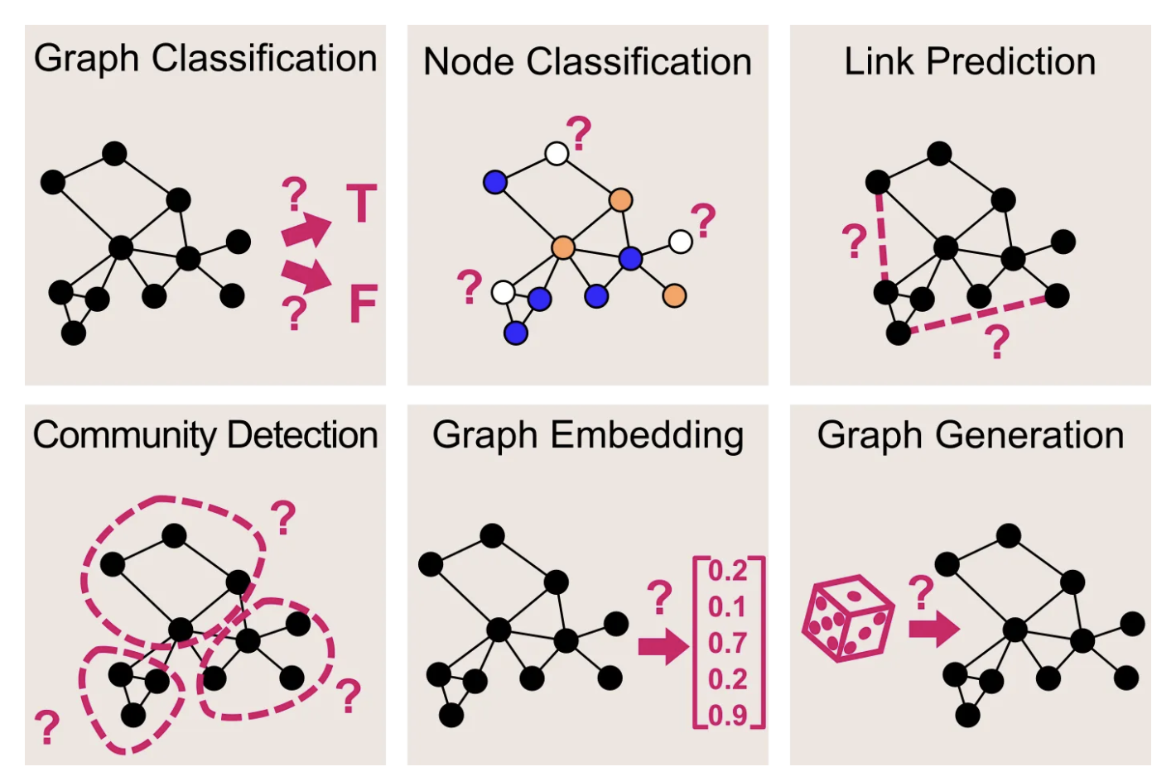
Graph Convolutional Networks – GCN (contd.)

Slide 19
DocGCN : Code Overview
04

Slide 20
Code Overview
Azure Devops :
kit-docgcn-layout-segment-classifier - Repos (azure.com)

Slide 21
DocGCN : Architecture & Pipelines
05

Slide 22
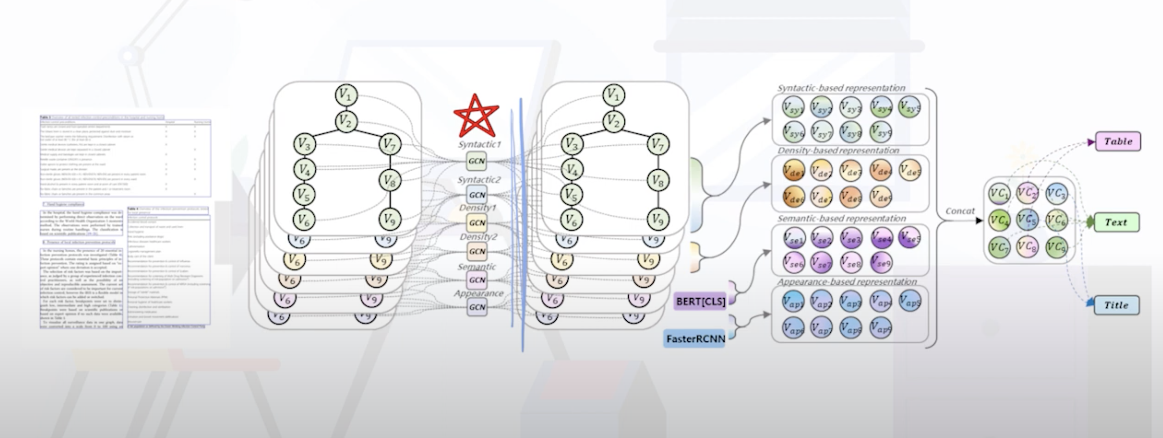
Design Solution Architecture

Slide 23
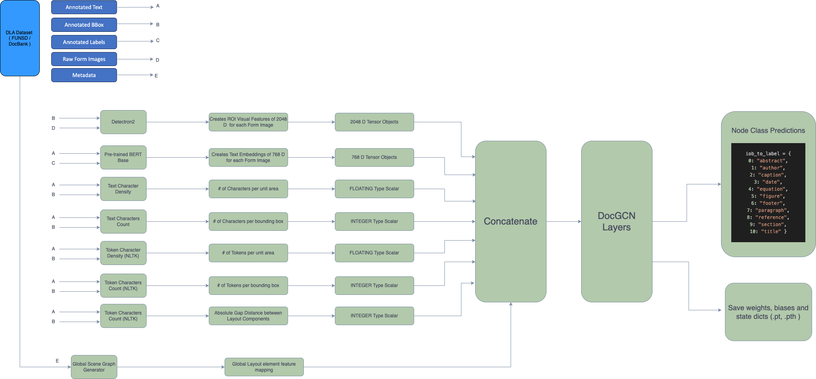
Training Architecture

Slide 24
DocGCN – Training Pipeline
Raw Image + Annotations
Image Pre-processing and visual features
Text Pre-processing and textual features
Relational Scene Graph generation (Global)
Step 1
Step 2
Step 3
DocGCN Layout Multi-class classifier model
Parent Child relation hierarchy based GCN
Layout Gap Distance based weighted GCN
Step 5
Step 4
Step 6

Slide 25
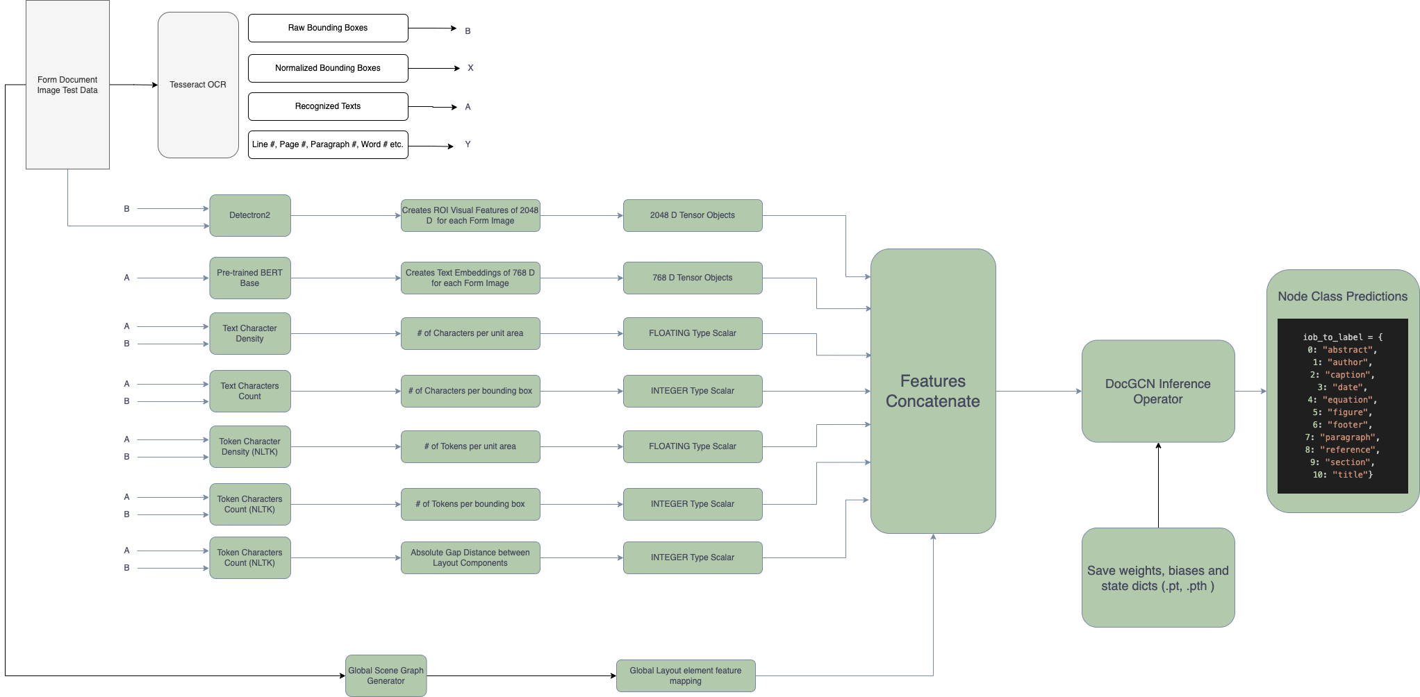
Inference Architecture

Slide 26
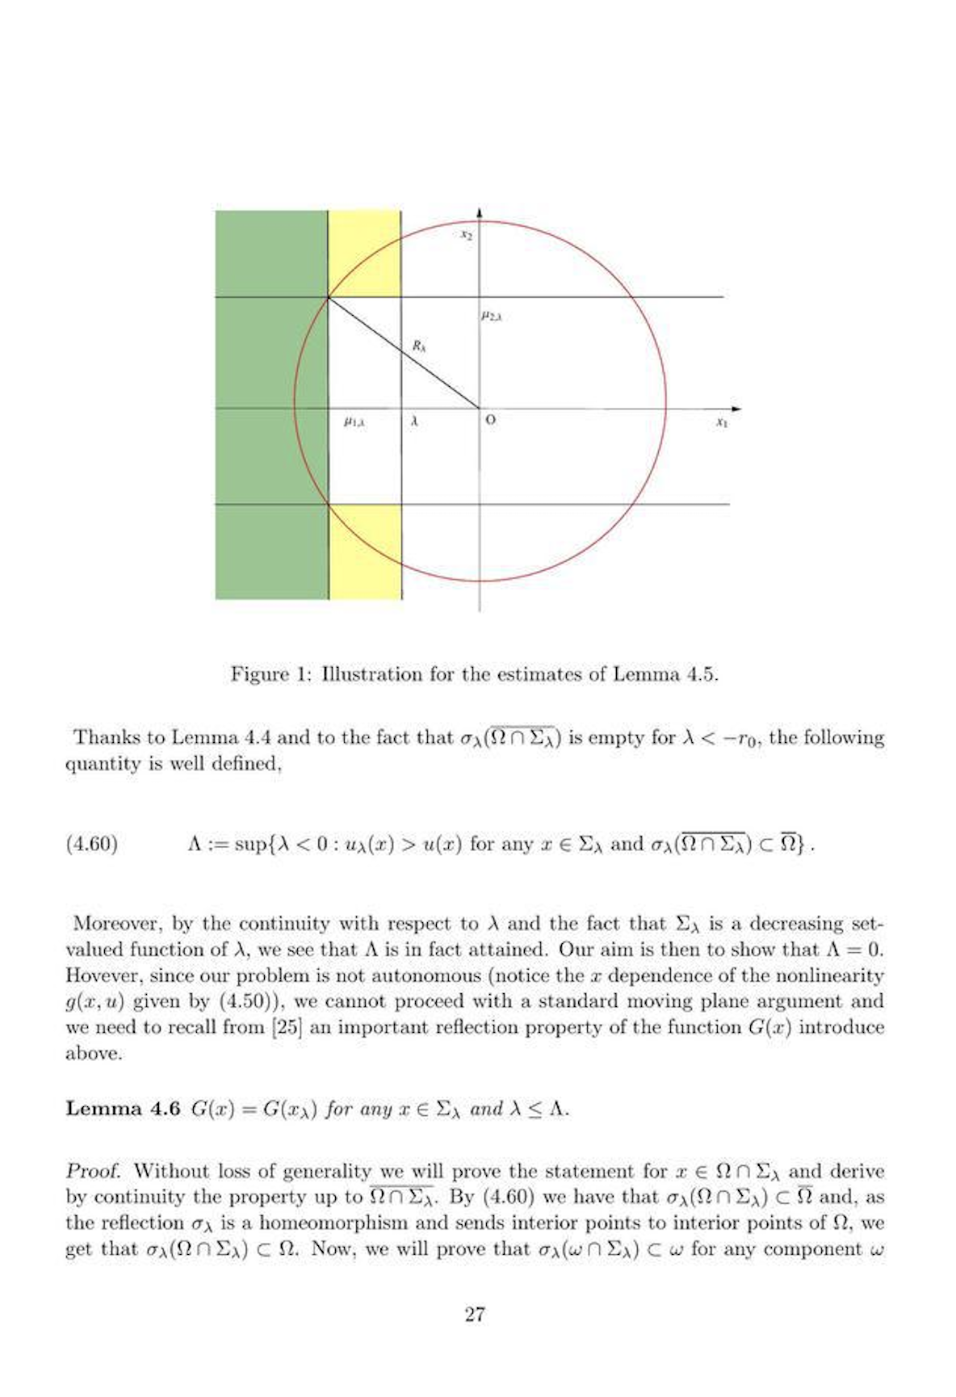
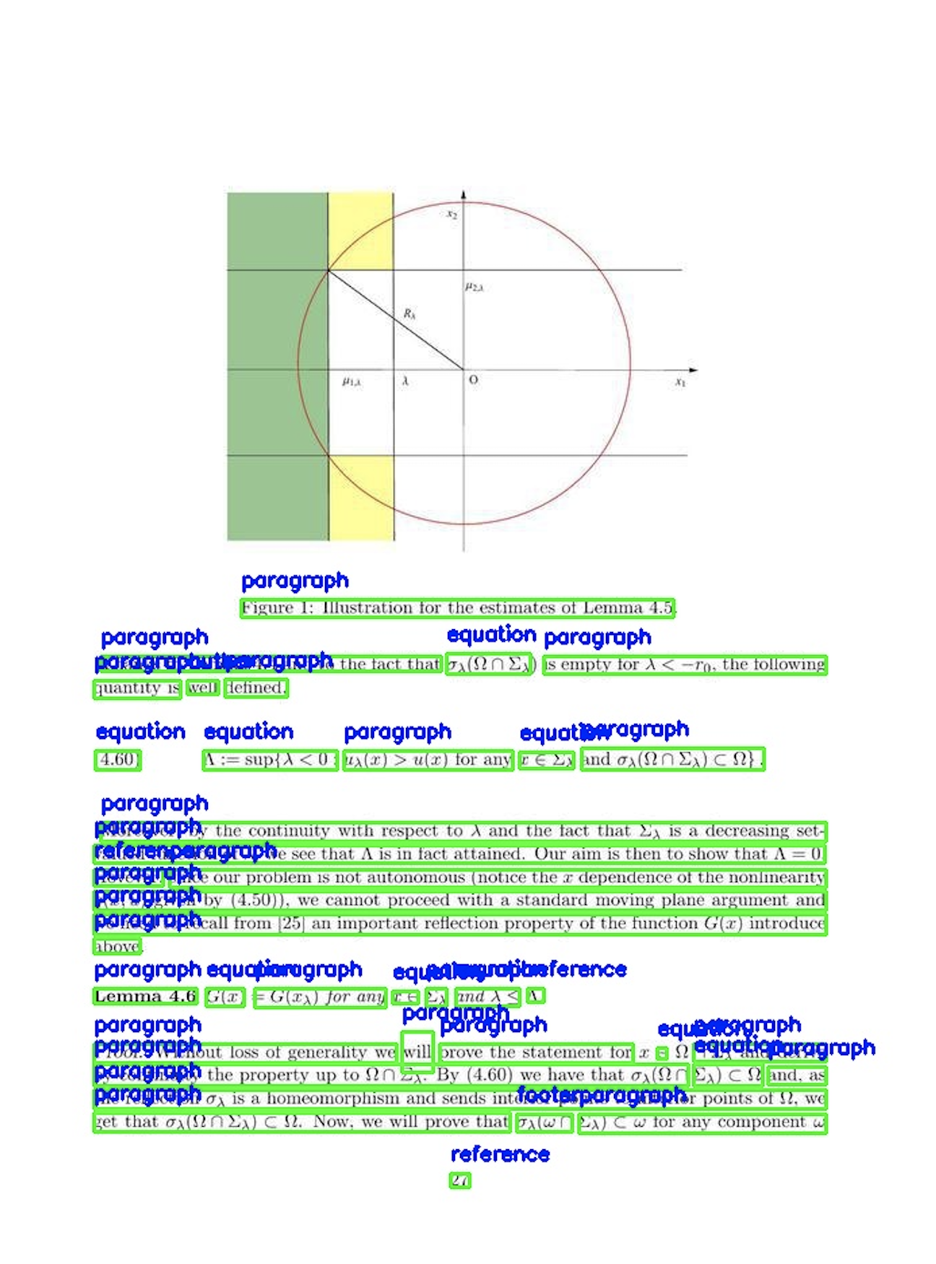
DocGCN – Inference Pipeline
Raw Test Image
PyTesseract OCR to get Text and Bboxes
Image features extraction
Text features extraction
Step 1
Step 2
Step 3
DocGCN Layout Multi-class classifier model
Feature concatenation for Dense layer
Node embeddings from GCNs
Step 6
Step 5
Step 4
Bboxes + Prediction Labels
OCR Overlay with Bbox merging
Step 7

Slide 27
DocGCN : Performance Results & Graphs
05

Slide 28
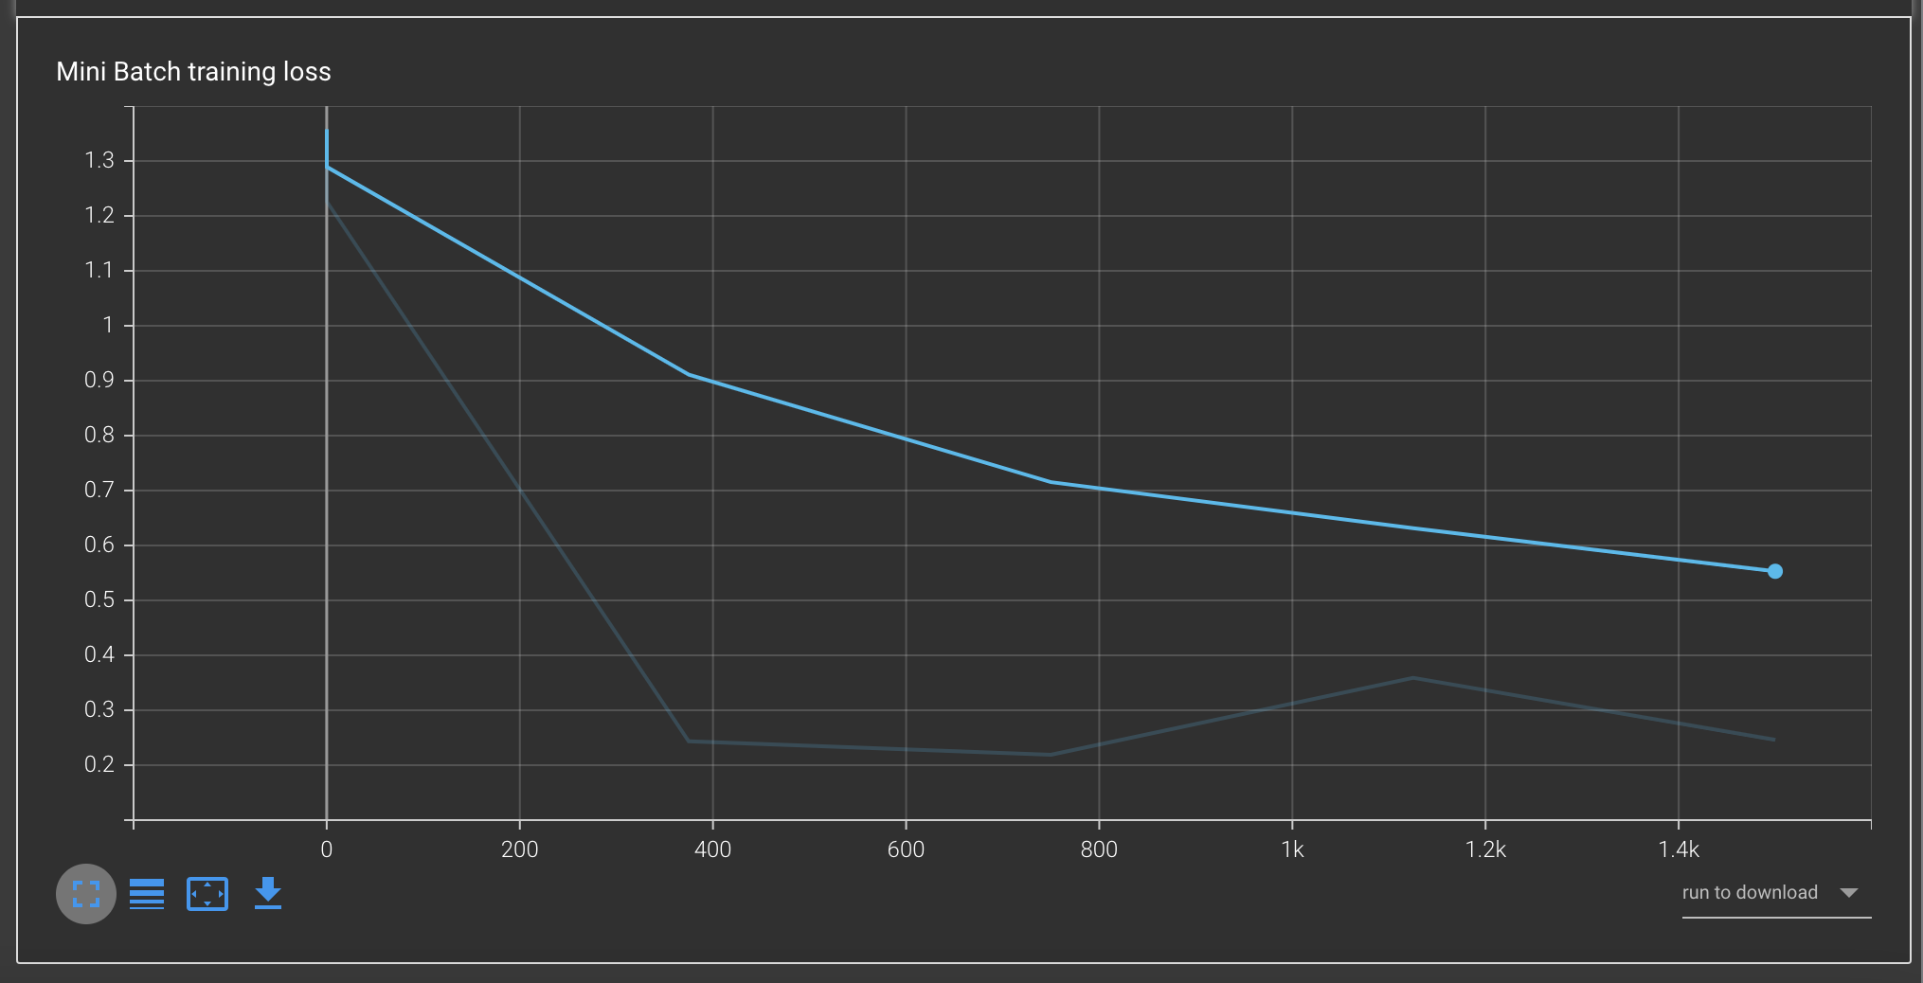
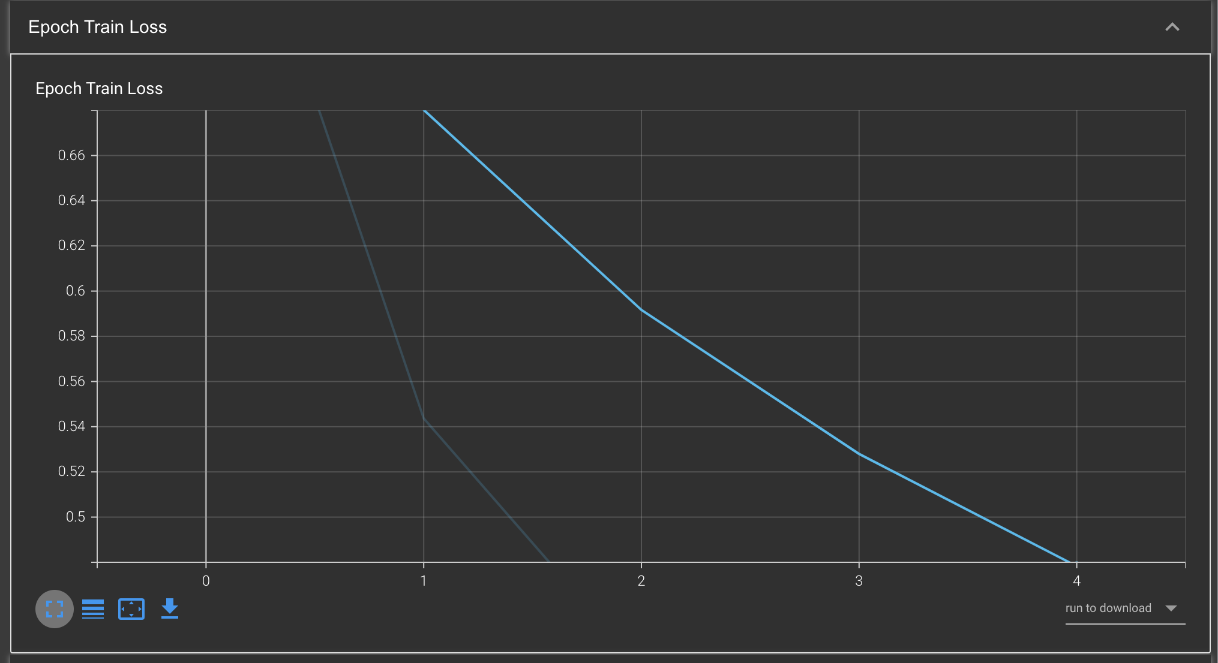
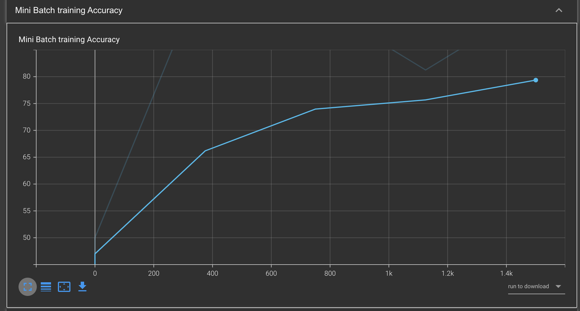
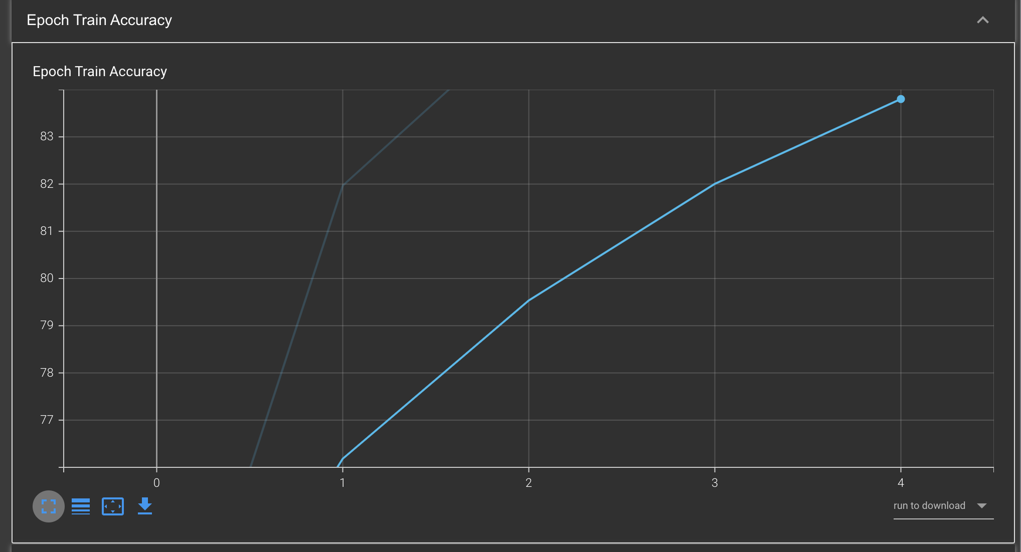
DocGCN Training Graphs

Slide 29
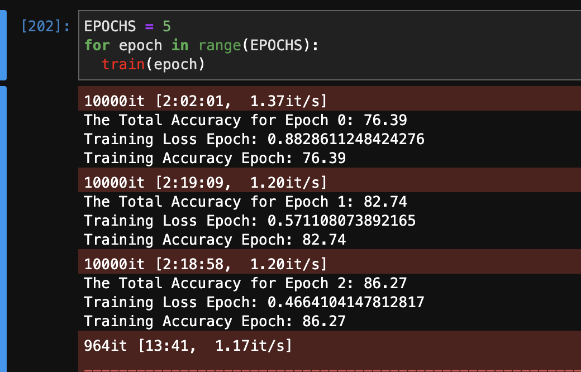
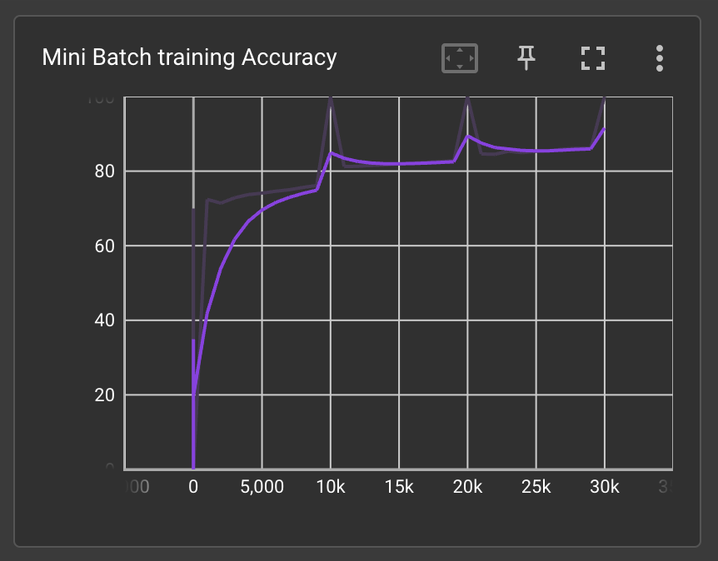
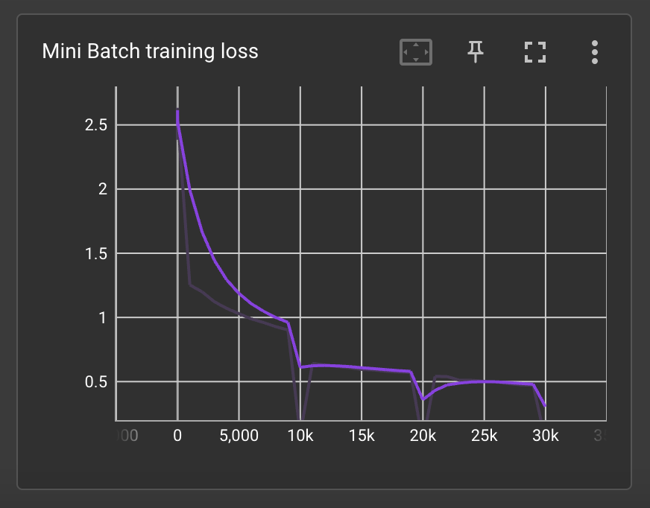
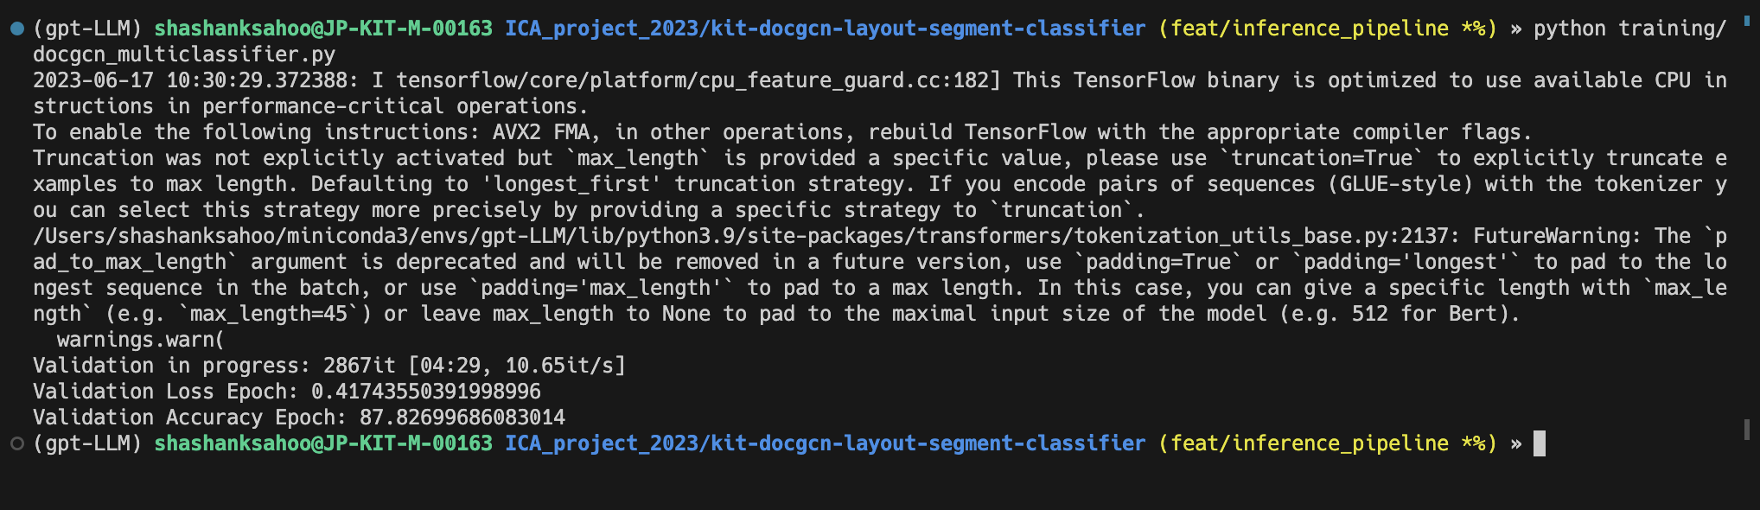
Metrics Highlights – DocGCN on DocBank

Slide 30
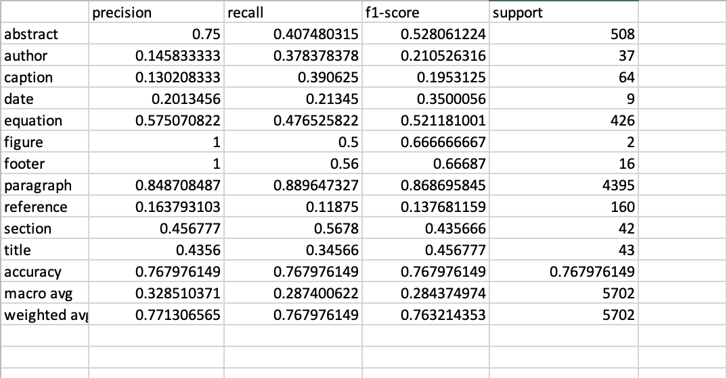
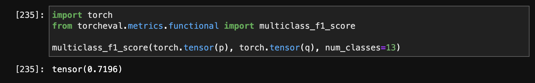
Model Performance Report – DocGCN on DocBank

Slide 31
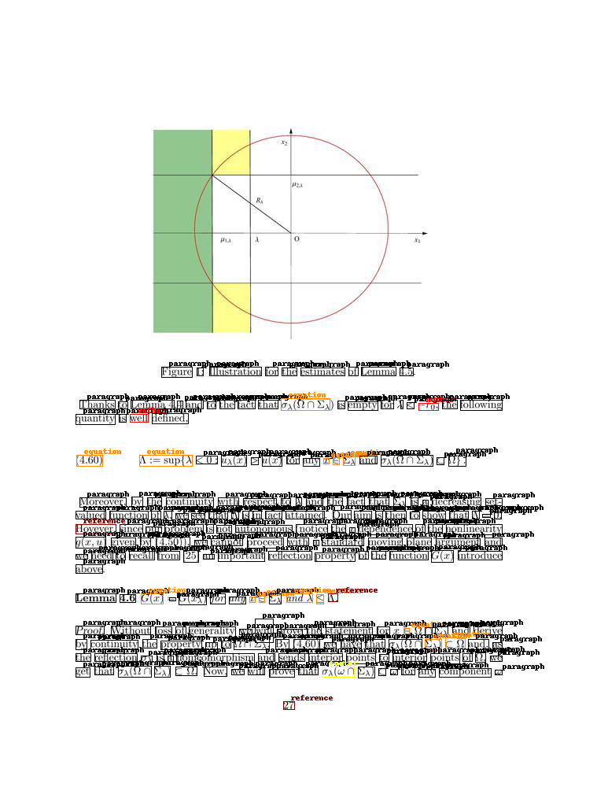
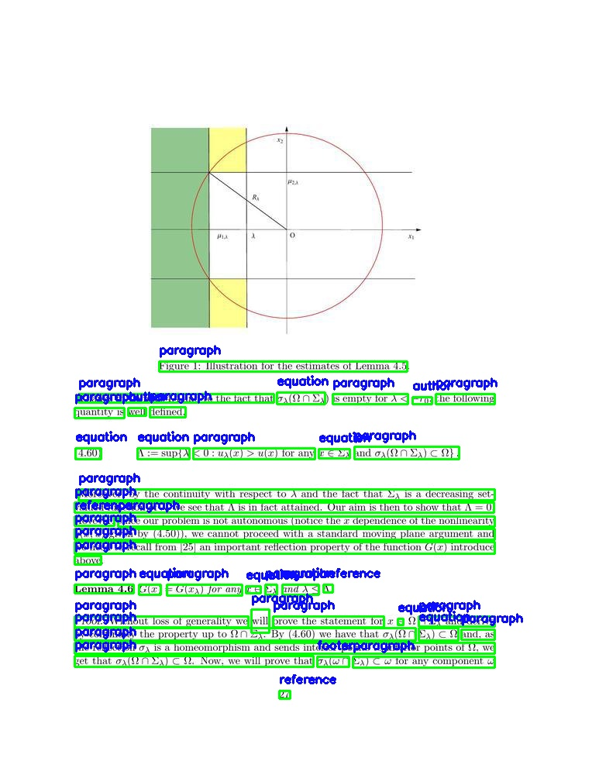
Sample Results– DocGCN on DocBank

Slide 32
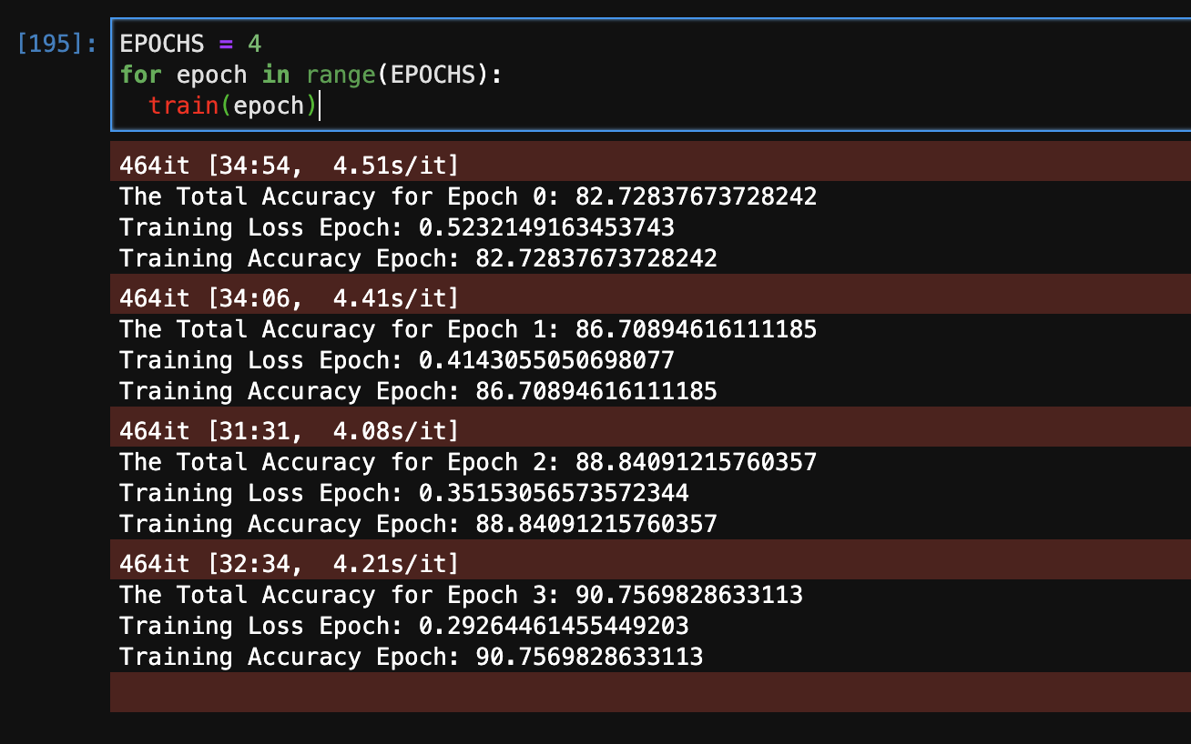
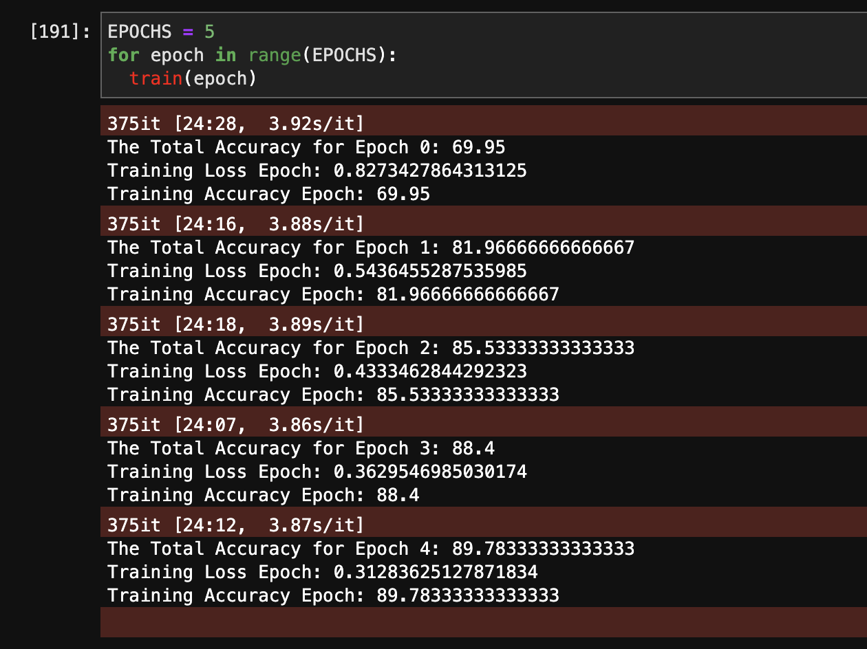
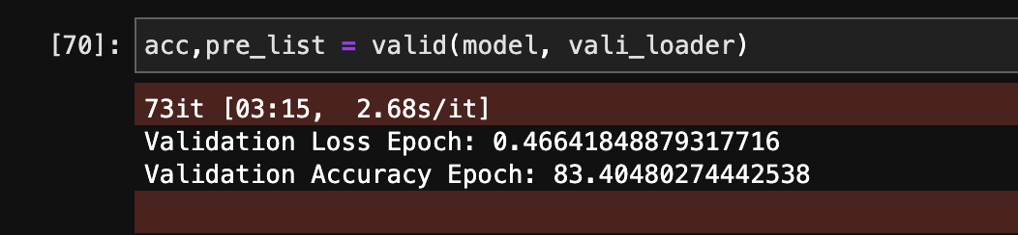
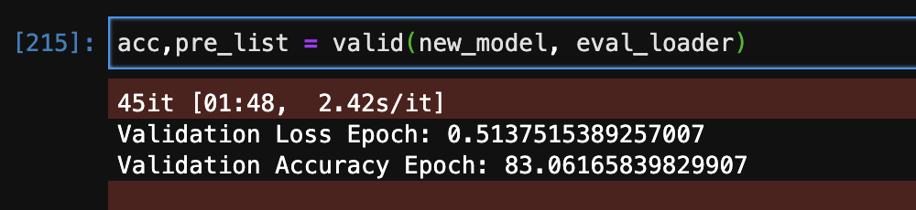
Metrics Highlights – DocGCN on FUNSD

Slide 33
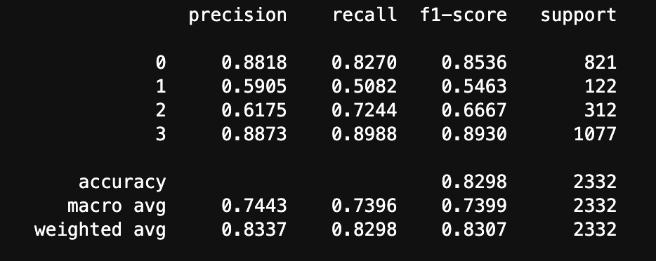
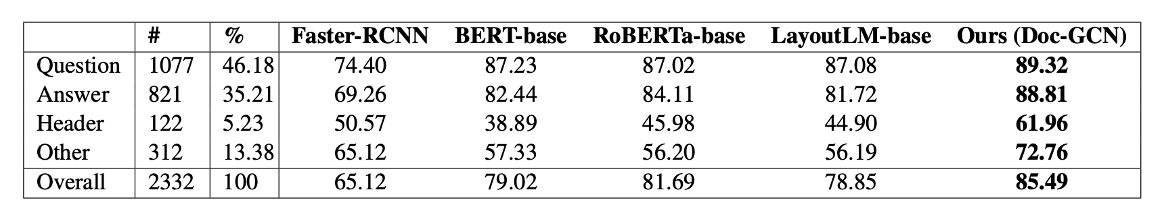
Model Performance Report – DocGCN on FUNSD
F1-Score Comparison
0 - Answer
1 - Header
2 - Other
3 - Question

Slide 34
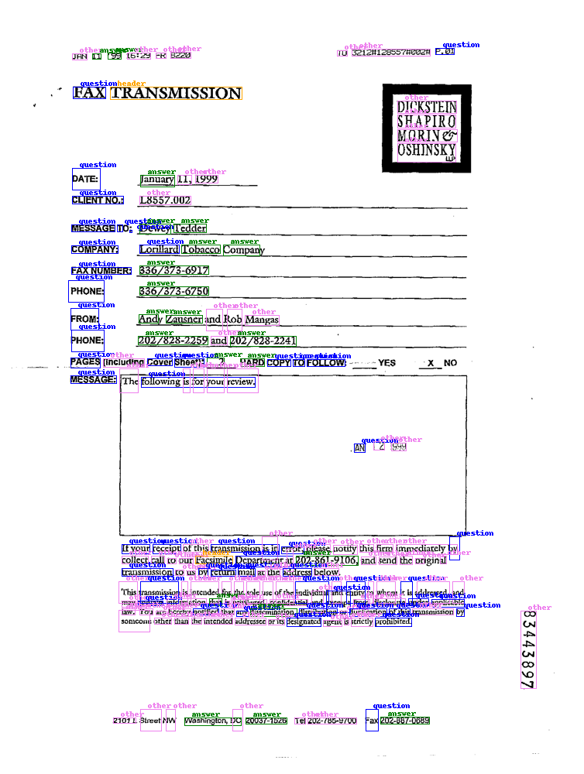
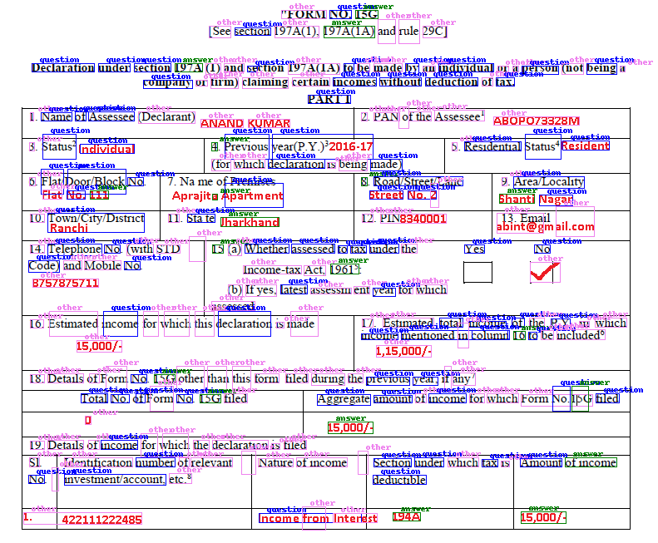
Sample Results– DocGCN on FUNSD

Slide 35
Performace Reports
06

Slide 36
MSP Requirements
<TBD>

Slide 37
Q&A
23

